Slide 1

Introduction to Kotlin

Slide 2
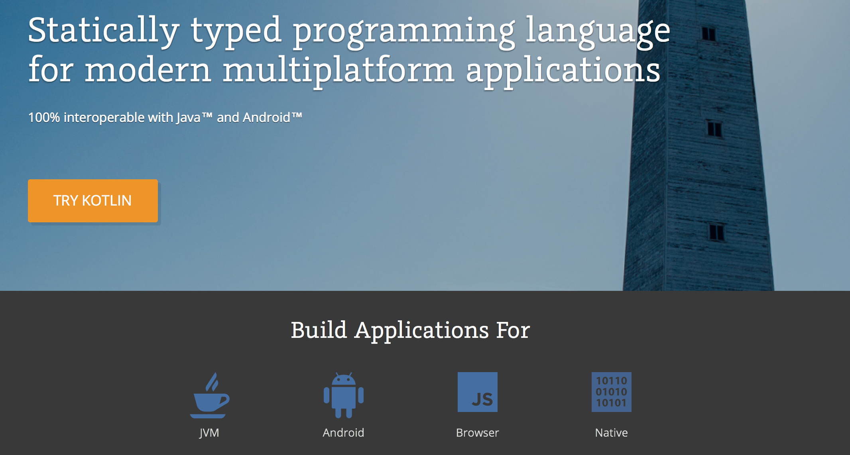

Slide 3
“We’ve built tools to support so many nice languages, and we’re still using Java”
–JetBrains, 2010

Slide 4
JetBrains and Google create a non-profit foundation to continue Kotlin development
Google officially support Kotlin development on Android
2017

Slide 5
Why should you care?
JetBrains created Kotlin to improve Developer Productivity and Developer Enjoyment
Kotlin comes from industry rather than academia - it’s pragmatic and solves problems faced by working programmers
It costs nothing to adopt, it runs on the JVM* and integrates easily with other Java code
You can use all of the existing libraries that you are familiar with
Backing from JetBrains and Google ensures that it won’t go away and has great tool support

Slide 6
IDE Time

Slide 7
Learning More
Official site: https://kotlinlang.org
Kotlin Koans: https://kotlinlang.org/docs/tutorials/koans.html
Read open source:
http4k: https://www.http4k.org
Exposed: https://github.com/JetBrains/Exposed

